Slide 1
The Absolute City Guide for Chennai, India
BY
Aniruth R
November 2019

Slide 2
Introduction
For many people visiting Chennai for a variety of reasons, they often find it struggling to know where to visit in the city for there isn’t a proper channel available to see the specialities of the area they are currently in and what can they expect in the area or which area is better suited for their needs. This assignment tries to identify this issue and come up with a solution for the same.

Slide 3

Business Problem
The objective of this capstone project is to analyse and select the best locations in the city of Chennai, India to explore several areas of interest. Using data science methodology and machine learning techniques like clustering, this project aims to provide solutions to answer the
question: In the city of Chennai, India, if a visitor is looking for a particular requirement, where would you recommend that they visit?

Slide 4
Target Audience and Data
Target Audience of this project
Data
This project is particularly useful for local travellers and tourists looking to different amenities in the city of Chennai.
To solve the problem, we will need the following data:
• List of neighbourhoods in Chennai. This defines the scope of this project which is confined to the city of Chennai
• Latitude and longitude coordinates of those neighbourhoods. This is required in order to plot the map and also to get the venue data.
• Venue data, particularly data related to user interests. We will use this data to perform clustering on the neighbourhoods.

Slide 5
Sources of data and methods to extract them
This Geonames.org page (http://www.geonames.org/export/zip/) contains a list of places in Chennai, with a total of 65 places. We will not use web scraping as the data is readily available in the required format. Then we will get the geographical coordinates of the neighbourhoods using Python Geocoder package which will give us the latitude and longitude coordinates of the Neighbourhoods.

Slide 6
Sources of data and methods to extract them
(contd.)
After that, we will use Foursquare API to get the venue data for those neighbourhoods. Foursquare has one of the largest database of 105+ million places and is used by over 125,000 developers. Foursquare API will provide many categories of the venue data, we are particularly interested in the venues data in order to help us to solve the business problem put forward.

Slide 7
Sources of data and methods to extract them
(contd.)
This is a project that will make use of many data science skills, working with API (Foursquare), data cleaning, data wrangling, to machine learning (K-means clustering) and map visualization (Folium). In the next section, we will present the Methodology section where we will discuss the steps taken in this project, the data analysis that we did and the machine learning technique that was used.

Slide 8
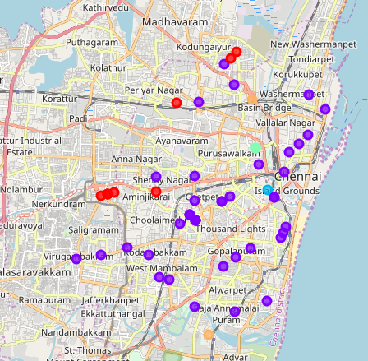
Result

Slide 9
Discussion and Review
From this project, it is clear that Central Chennai has a variety of options for food lovers and caters to several different cuisines whereas the other parts of Chennai has so many other options to choose from.

Slide 10
Thank you for following my presentation. It was indeed a great experience doing this project.

